Slide 1
My Experience Getting an Internship as a Math Major
Adam Chen

Slide 2
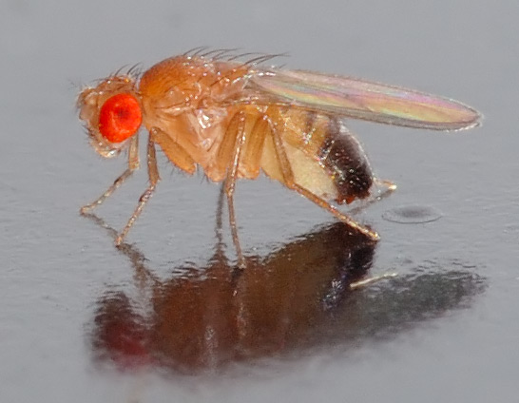
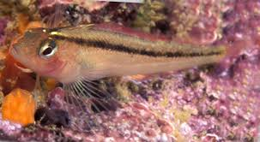
My Background
Notes:
No work experience other than mom’s and sweet tomatoes

Slide 3
My Background
Summer 2015
Currently
Notes:
Interviewed a few times
Breifly talk about what each is and what its like working there
Draw on my experiences
BCACAD: excel
OURI
AT: training why I like it

Slide 4
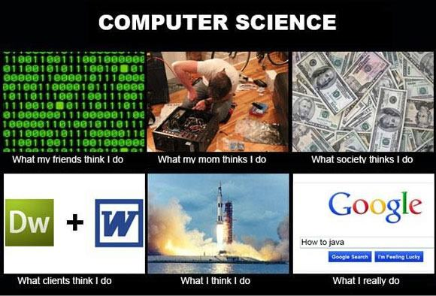

Slide 5
Develop a Strategy
Define the type of lifestyle you want
  Most of your life is at work
Define what you want to do
  Minor in something you are interested in
Consider timing
  Shotgun vs. targeting
Be flexible
  Relocate
Notes:
Never did this until too late
Applying takes a long time
A lot of work. Be aggressive
Experience all four
Flexible: open minded

Slide 6



Searching for Internships
Internet
  Usajobs.gov
  Internships.com
  Indeed.com
  LinkedIn
What to search for
“_____” Analyst
Data scientist
Developer/programmer
School
  Math Department
  FAU internships
  Career Development Center
Notes:
USA JOBS: statistician, economist
Current Internship from school
Businessm Pricing, operations research, financial, data analyst
Data scientist, developer, programmer

Slide 7
Develop Job Specific Skills
Be prepared to self learn
  Take on a project and document it
Technical skills
  Programming
    Python, C++, C#, etc.
    SQL
    R
  Excel
Soft skills
  Public speaking
  Team work
Notes:
Look ahead to entry level positions for skills you need
Shows you are a self starter
Publish it somehow
Joe Salvatore

Slide 8
Take Advantage of the Career Development Center!
Resume critiques
  Feedback from human resource representatives
  Tailored advertisement
Workshop and events
  Dared to be Prepared
  Internship workshop
  LinkedIn workshop
Mock interviews
Notes:
Broward County
Resume got responses tailored
Dare to be prepared: found out about how well we can do programming

Slide 9
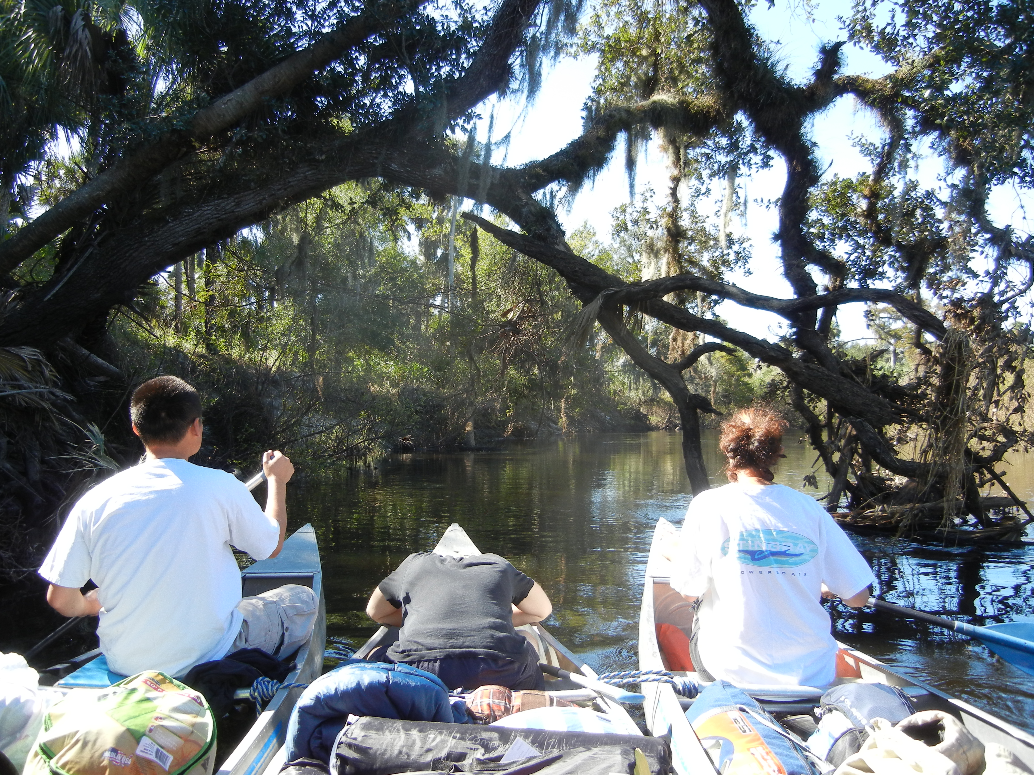
Hiring a Person
Be active in Math Club!
  Officer position
Hobbies/volunteer
DIS
Little experiences count
  Trail of Terror
  Working at mom’s
Follow up or reach out
Notes:
Talking about interests
High ranking position later on officer role shows good managerial work
Motivated
American traveler: what do you like to do on your free time?
not going to be able to balance your life

Slide 10
Success! Or Not…
Notes:
Interview doesn’t mean you have the job
Don’t get discouraged its part of the learning process

Slide 11
Starting Out
Raw Data
Analyst
Upper Management
Feel incompetent in the beginning
  Not as complex as school
  Lateral thinking
Notes:
I got analyst role now
Not as complex as say a math course (linear regression)
Can be. Flex shopper. Looking for someone with masters level (data science).
American Traveler training and seeing different roles
Analyst chef analogy
Know the guy to get training.
Roberto
Helped with American traveler job. Saying I’m learning excel
You will be the math guy

Slide 12
Not like Academia
More about making a decision
Data is dirty
  Things you can’t control or account for
No one really checks your work
Notes:
Most of the time checking data and cleaning it up
Here you go good luck: doesn’t know what they’re doing
Dump the problem on you.

Slide 13
Work Ethic
Check your work more than you need too
Treat your internship like a real job
Volunteer to take on more responsibility or projects when possible/appropriate
Time management skills
Come in 10-15 minutes early and stay 10-15 minutes late
Notes:
Analyst roles : 50-70 hrs a week
Goes back to define your life style

Slide 14

Don’t Submit Unless You Approve
Notes:
Don’t let anything leave you without your approval

Slide 15

Social Skills
Attention introverts!
Working with non quantitative people
  Tutor low level math
Get to know your coworkers
Manners

Slide 16
Networking
Making positive connections with people
Let people know what you’re doing
Extracurricular activities
Professors
Peers
  Recommend you for internships when they are done
Never know who you’ll get opportunities from
Notes:
Improv

Slide 17
Key Points
Develop a strategy
Hone job specific skills
Take advantage of your resources
Be active in clubs/organizations
Have a strong work ethic
Work on your social/networking skills

Slide 18
Questions?

